Slide 1
Dr.Kirti Mathur

Slide 2
OPERATING SYSTEM

Slide 3
VIRTUAL MEMORY

Slide 4
Page replacement algorithms
Page replacement algorithms are the techniques using which Operating System decides which memory pages to swap out, write to disk when a page of memory needs to be allocated.
Paging happens whenever a page fault occurs and a free page cannot be used for allocation purpose accounting to reason that pages are not available or the number of free pages is lower than required pages.

Slide 5
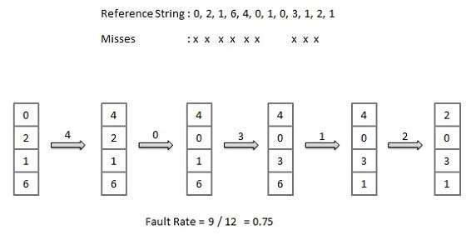
First In First Out (FIFO) algorithm
Oldest page in main memory is the one which will be selected for replacement.
Easy to implement, keep a list, replace pages from the tail and add new pages at the head.

Slide 6
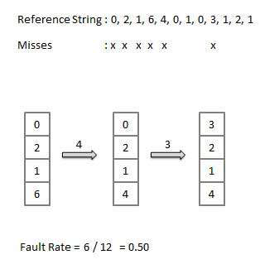
Optimal Page algorithm
An optimal page-replacement algorithm has the lowest page-fault rate of all algorithms.
Replace the page that will not be used for the longest period of time . Use the time when a page is to be used.

Slide 7
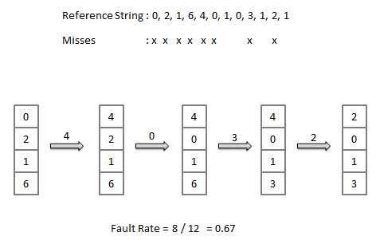
Least Recently Used (LRU) algorithm
Page which has not been used for the longest time in main memory is the one which will be selected for replacement.
Easy to implement, keep a list, replace pages by looking back into time.

Slide 8
END

